Slide 1

Привітання ...

Slide 2

Змійка

Slide 3
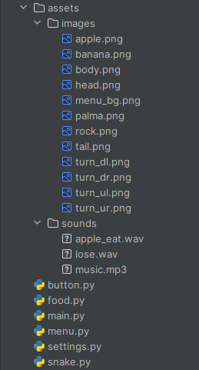
Структура мого проекту “Змійка”
В папці assets

Slide 5

Write your topic or idea
Paragraph that dives deeper into the topic or main idea to build a clearer understanding for the reader.

Slide 6

Original, impactful, or inspiring statement
— Author of the quote or statement

Slide 7

Original, impactful, or inspiring statement
— Author of the quote or statement

Slide 9
Дякую за увагу!

